Slide 1
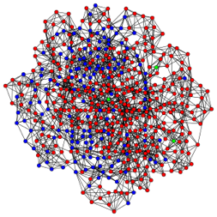
Influenza A virus at the human-animal interface
Tavis Anderson
Virus and Prion Research Unit
National Animal Disease Center
United States Department of Agriculture Agricultural Research Service

Slide 2
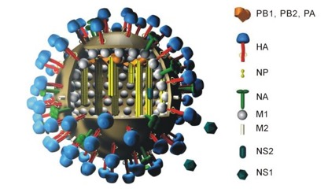
Influenza A virus in swine
Negative-sense, single-stranded RNA virus
Subtype name derived from HA and NA number
Swine H1N1, H1N2, and H3N2
Significant diversity withing the subtypes
HA is target of neutralizing antibodies
Antigenic drift
Co-infection and reassortment
Antigenic shift

Slide 3
What’s happening with IAV in swine in the United States?

Slide 4
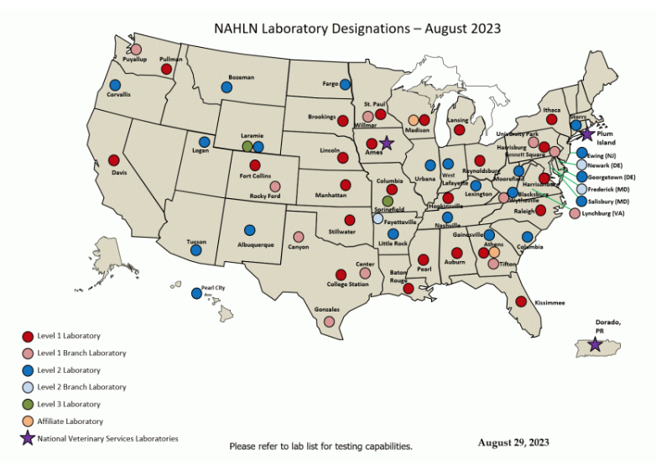
USDA IAV in Swine Surveillance System
Implemented in November 2009
~40 labs in the National Animal Health Lab Network
Passive surveillance
HA and NA sequenced
2010-2023 subset are whole genome sequenced
2023-> all submissions
~11,000 strains https://flu-crew.org/

Slide 5
Constant circulation of different H1 HA
n=9
https://flu-crew.org/ ~11,000 USDA strains
Blake Inderski
Arendsee et al (2021) MRA
https://github.com/flu-crew/octoFLU and https://github.com/flu-crew/octoflushow

Slide 6
Constant circulation of different H3 HA
n=9
https://flu-crew.org/ ~11,000 USDA strains
Blake Inderski
Arendsee et al (2021) MRA

Slide 7
What’s happening with IAV in swine in other countries?

Slide 8
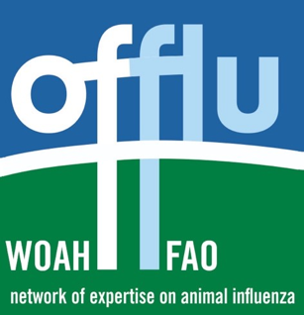
OFFLU IAV in Swine Working Group
WHO biannual vaccine consultation meeting
Pandemic preparedness, i.e., animal IAV discussion
~12-15 countries sharing data and isolates
Centralized at USDA-ARS-National Animal Disease Center and the UK-Animal and Plant Health Agency
World Organization for Animal Health/Food and Agriculture Organization Network of Expertise on Animal Influenza
https://www.offlu.org/

Slide 9
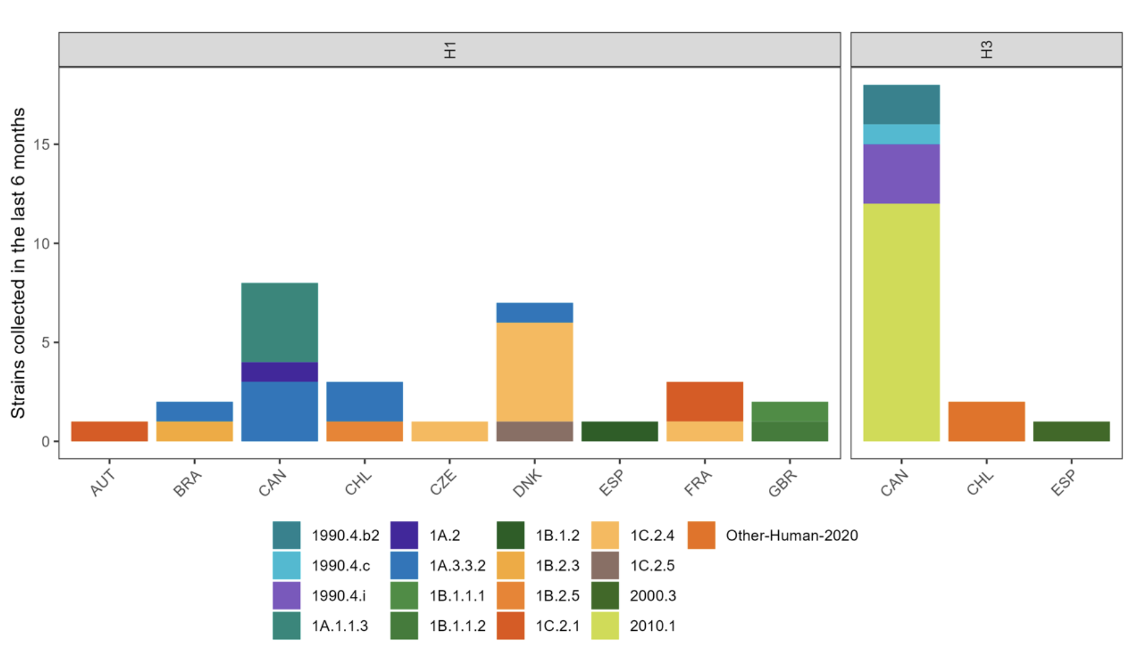
Global: Constant circulation of different H1 and H3 HA
17 different HA genes detected within the last 6 months!
OFFLU team (February 2024)

Slide 10
Does IAV in swine matter for public health?

Slide 11
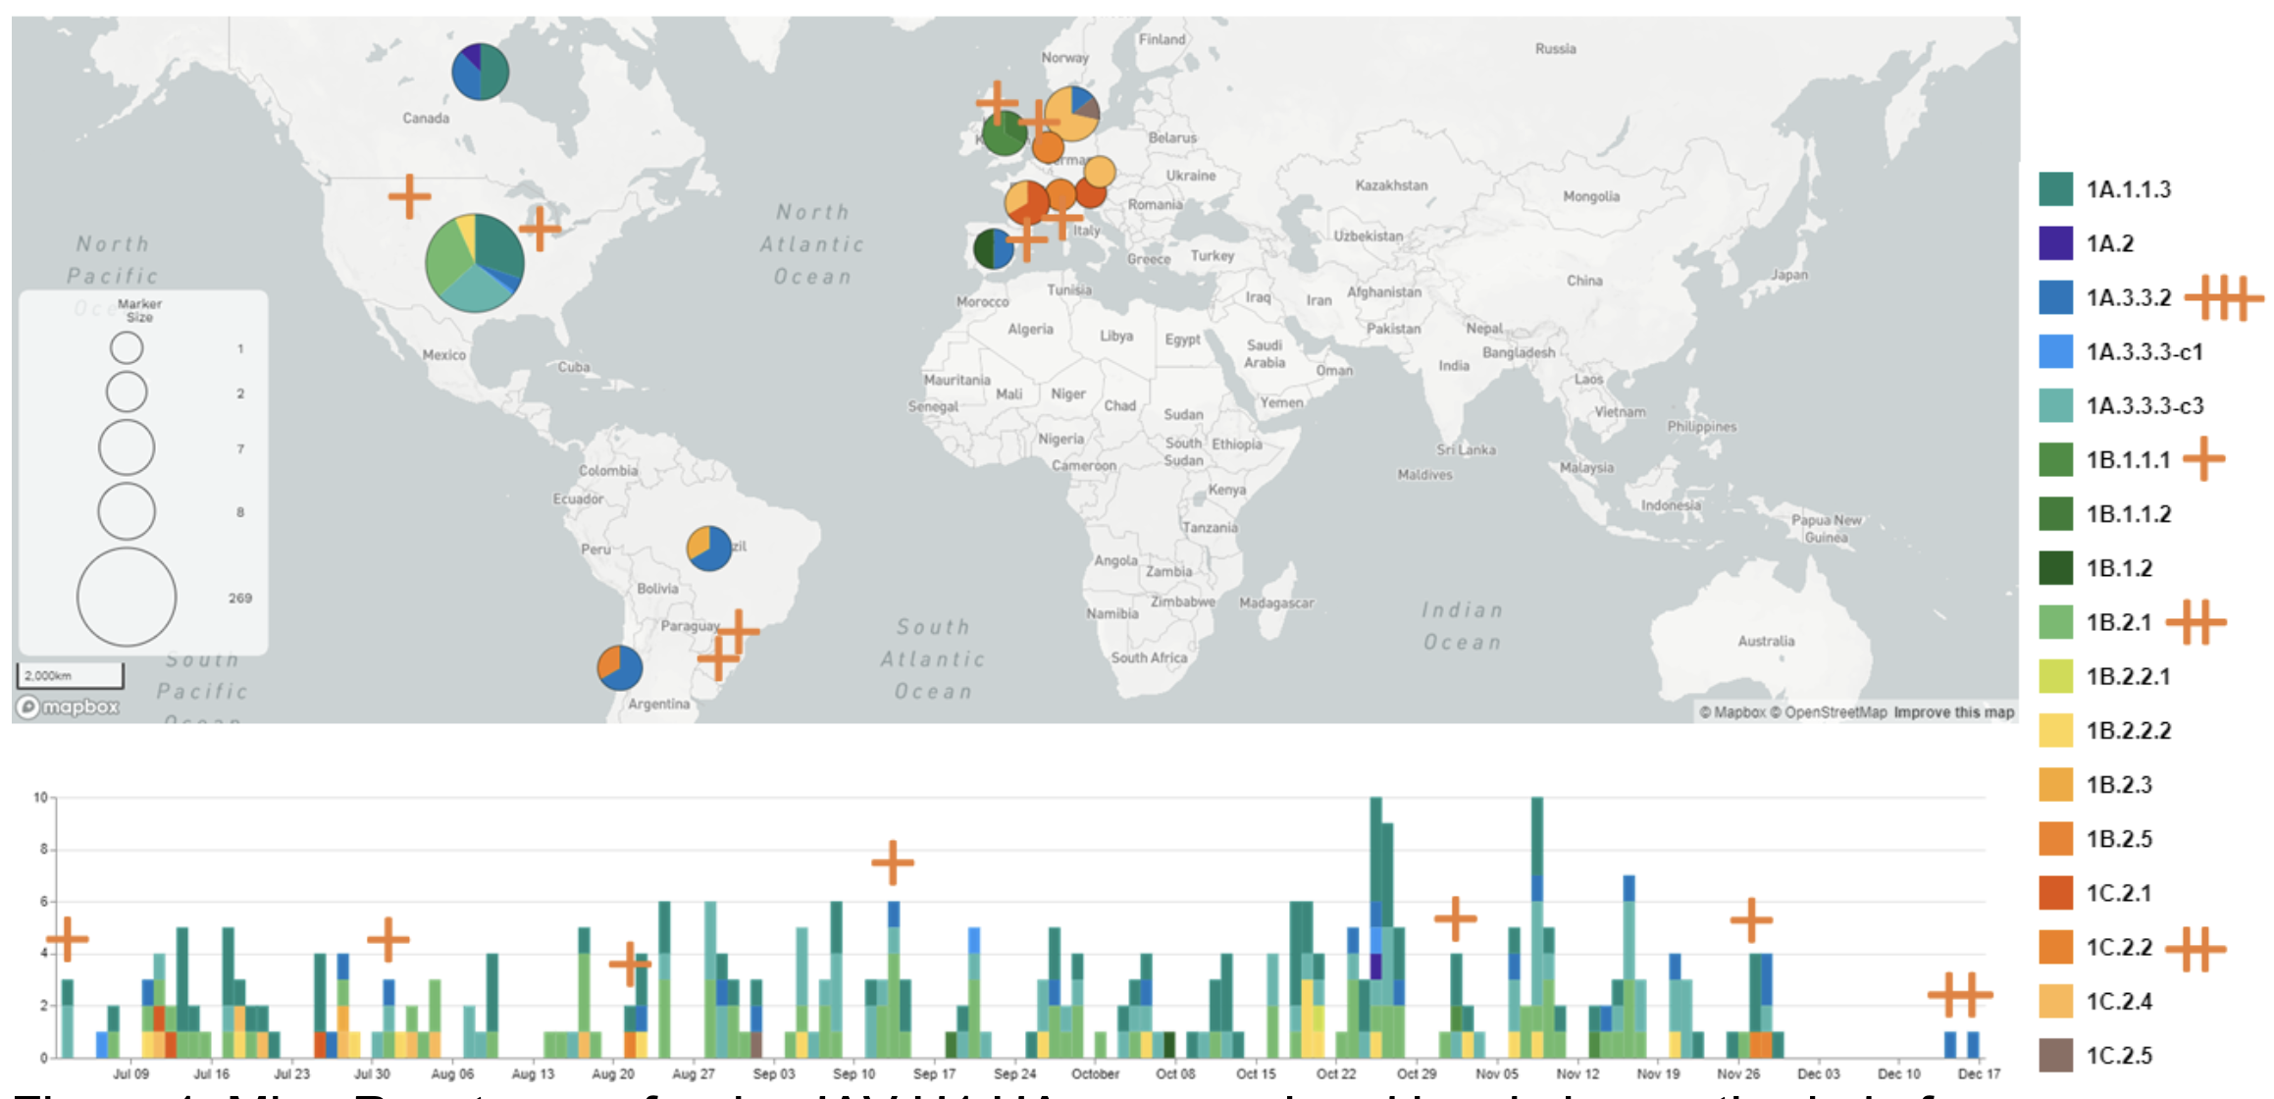
Regular zoonotic events from different H1 and H3 HA
Between June 2023 and January 2024 – 8 H1 “variant” infections from 4 H1 HA clades, 1 H3 variant
OFFLU team (February 2024)

Slide 12
Why is swine IAV such a challenging problem?

Slide 13
Almost all swine IAV are derived from human IAV
n = 366 human-to-swine from 2009 to present
(n = 18 swine-to-human)
Markin et al. (2023) PLoS Pathogens

Slide 14
Constantly recharges the evolutionary battery
Season | Total spillovers | Maintained spillovers (longer than one year) | Average spillover length (years) | Longest spillover (years)
10-11 | 11 | 0 (0%) | 0.6 | 1.0
11-12 | 4 | 3 (75%) | 2.4 | 6.6
12-13 | 13 | 6 (46%) | 2.0 | 7.1
13-14 | 24 | 7 (29%) | 1.3 | 7.4
14-15 | - | - | - | -
15-16 | 51 | 9 (18%) | 0.9 | 5.6
16-17 | 7 | 1 (14%) | 0.6 | 2.3
17-18 | 33 | 6 (18%) | 0.8 | 3.7
18-19 | 80 | 16 (20%) | 0.7 | 2.7
19-20 | 69 | 18 (26%) | 0.7 | 1.8
Rule mining to identify season of spillover
~20% persist in swine, significant contribution to genomic diversity
Markin et al. (2023) PLoS Pathogens

Slide 15
What happens when these human viruses get into pigs?

Slide 16
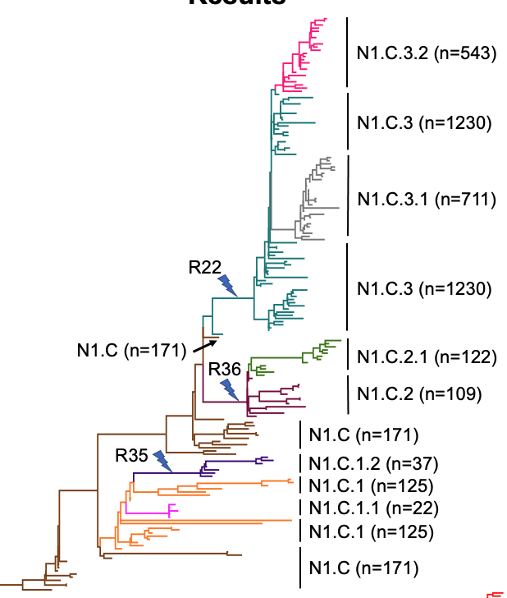
They reassort: this can be a “clade creating” process
R22, R35, R36 were speciation events
Hufnagel et al. (2023) Virus Evolution
TreeSort:
https://github.com/flu-crew/TreeSort

Slide 17
Or reassortment subtly shapes the evolutionary landscape…
Zeller et al. (2021) Virus Evolution

Slide 18
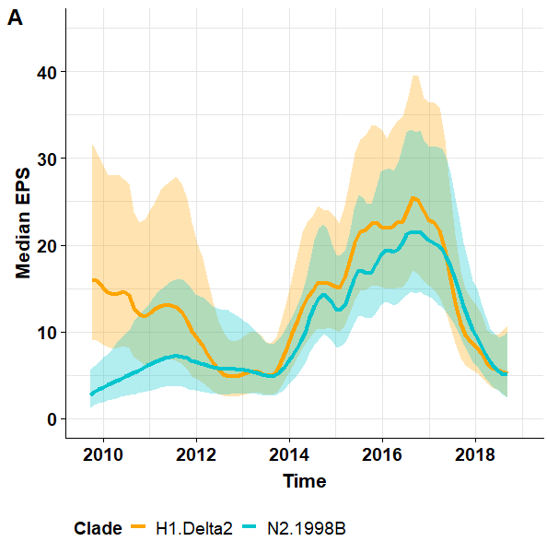
… through epistatic changes in diversity
Reassortment
Reassortment in the 1998A N2 lineage – H3 to H1 pairing
Zeller et al. (2021) Virus Evolution

Slide 19
Resulting in small, but meaningful structural changes
Table 1
Notes:
And those evolutionary trajectories are subtlely changing the structure of the protein
Basically, across those 3 clades – there are a number of amino acid sites in important antigenic regions that are undergoing diversifying selection
And, that diversifying selection is affecting the structure of the protein so that each of the clades is slightly different

Slide 20
The small changes reduce the efficacy of human IAV vaccines
Every swine representative has drifted from human IAV vaccines
Markin et al (2023) PLoS Pathogens

Slide 21
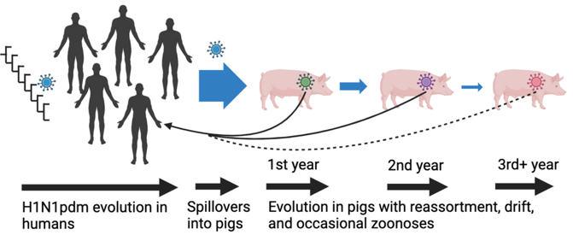
Human-to-swine, swine-to-swine, swine-to-human – it’s FAST!
A handful of AA changes is all it takes to reduce Ab binding…
Markin et al (2023) PLoS Pathogens

Slide 22
Samples submitted through NAHLN were confirmed as HPAI H5N1 on March 25, 2024

Slide 23
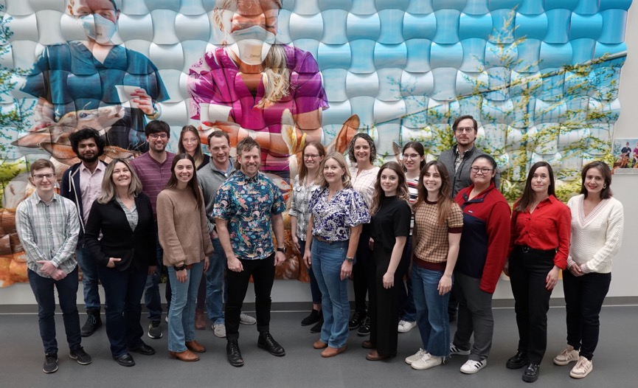


Garrett – population genetics
Blake – term technician
Carl – evolutionary biology
Sanket – PhD student
Sriram – PhD student
Alexey – computer scientist
Megan – DVM/PhD student
Thao – PhD student

Slide 24
Single spillover in late 2023
Nguyen et al. bioRxiv (in review)

Slide 25
Reassortment in wild birds preceded spillover
TreeSort: https://github.com/flu-crew/TreeSort

Slide 26
How could it have gone from a single confirmed case on March 25, 2024… to hundreds?

Slide 27
Animals are moved... and the virus too
Field Epidemiologic Investigation Services, and the National Veterinary Services Laboratories, USDA-APHIS

Slide 28
From one location at least three clusters emerged
B
C
D

Slide 29
Asymptomatic dairy cattle drove dissemination

Slide 30
What is happening now it’s in dairy cattle?

Slide 31
In dairy cattle, then back into other hosts
More than 10 cattle to other host transmission events
Poultry
Wild birds and peridomestic mammals (cats, raccoons)
Arendsee et al. (2022)
smot: https://github.com/flu-crew/smot
HA tree

Slide 32
Low frequency within host variation and purifying selection
Gene | Coding region change | Functional type | Cattle with variant (#) | Mean allele frequency | Consensus sequence | Low frequency variants
HA | E91K | increase human adapt | 1 | 0.05 | 0 | 1
HA | S137F | change human adapt | 1 | 0.375 | 0 | 1
HA | Q154R | change pathogenicity | 6 | 0.012 | 0 | 6
HA | 172A | increase human adapt | 213 | 0.999 | 213 | 0
HA | A172T | decrease human adapt | 9 | 0.891 | 8 | 1
HA | N209T | change human adapt | 1 | 0.012 | 0 | 1
HA | Q234K/R | change virulence | 9 | 0.044 | 0 | 9
HA | G240R | increase human adapt | 1 | 0.025 | 0 | 1
HA | S336N | change pathogenicity | 17 | 0.885 | 15 | 2
HA | P337L | increase virulence | 8 | 0.715 | 5 | 2
MP | R77K | change pathogenicity | 1 | 0.006 | 0 | 1
MP | S207G | decrease pathogenicity | 4 | 0.013 | 0 | 4
NA | A55T | virulence / host range | 222 | 0.997 | 222 | 0
NA | E57G | virulence / host range | 7 | 0.016 | 0 | 7
NA | V67I | virulence / host range | 222 | 0.997 | 222 | 0
NA | N70S/D | virulence / host range | 221 | 0.99 | 221 | 2
NA | N71S | virulence / host range | 88 | 0.999 | 88 | 0
NA | T438A/I | increase antiviral resist | 3 | 0.627 | 2 | 1
NP | V105M | decrease pathogenicity | 221 | 0.998 | 221 | 0
NS | V205I/G | change virulence | 222 | 0.998 | 222 | 0
NS | E229K | change virulence | 18 | 0.968 | 18 | 0
PB2 | V495I | change mammal adapt | 211 | 0.997 | 211 | 0
PB2 | E627K | increase virulence/adapt | 1 | 0.327 | 0 | 1
PB2 | M631L | increase mammal adapt | 214 | 0.999 | 214 | 0
PB2 | D701N | increase pathogenicity | 2 | 0.015 | 0 | 2
dn/ds <1 suggesting weak purifying selection
No evidence that low frequency variants are affecting phenotype
Some genomic signatures emerged in wild birds and have persisted, e.g., HA 172A
“looks” like IAV evolving
PB2 – E627K in one animal
PB2 – D701N in two animal
PB2 – M631L in 214 animals
Hutter et al. (in prep)
https://github.com/flu-crew/Flumina

Slide 33
What are we doing next?

Slide 34
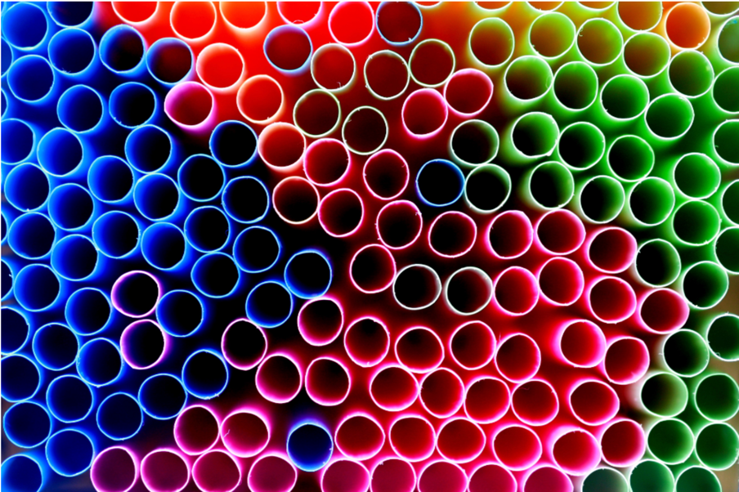
PARNAS: an objective selection of representative strains
Markin et al. (2023) Systematic Biology: https://github.com/flu-crew/PARNAS

Slide 35
The main PARNAS sampling strategies
Selecting k best representatives
Covering all diversity
r
Optimal subsampling
under r
k=3
1
2
3
The user sets k
The user sets
the radius r

Slide 36
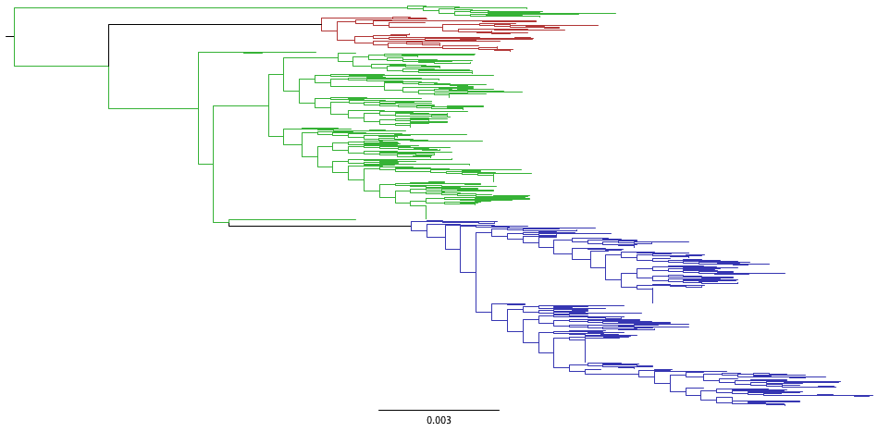
Selecting the 3 most representative strains
Find the 3 best strains and identify the groups that each strain represents
parnas -t H1N1_human_2020_IRD.rooted.tre -n 3 --color "parnas-n3-colored.tre"
MT331335|A/Pennsylvania/12/2020|USA|H1N1|02/03/2020
MT331244|A/New_Mexico/05/2020|USA|H1N1|02/10/2020
MT303640|A/New_York/17/2020|USA|H1N1|01/25/2020
[parnas 16:31:32] Chosen representatives account for 43.26% of overall diversity.

Slide 37
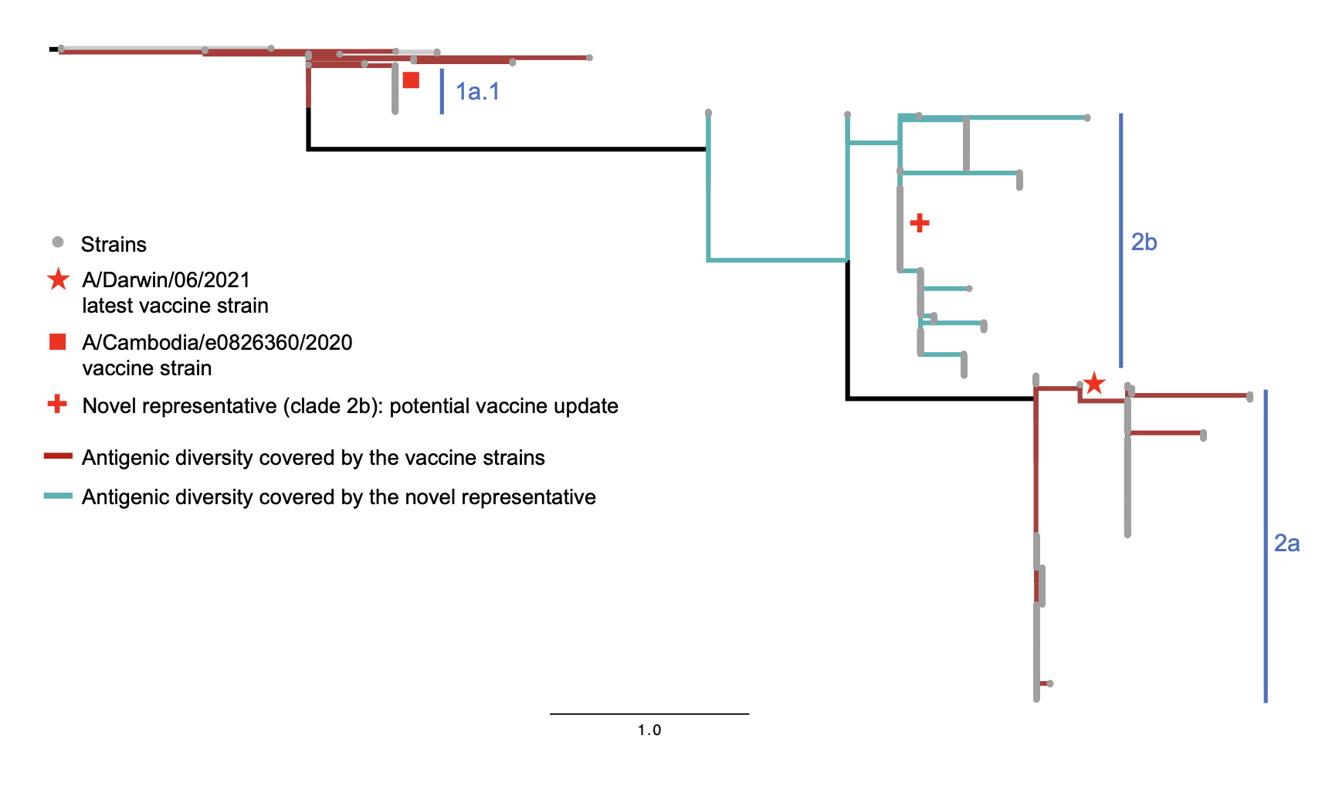
Identify gaps in representative coverage and identify genetically novel genes
~2000 human H3 HA genes weighted using HI data (2 AU threshold)
Markin et al. (2023) Systematic Biology: https://github.com/flu-crew/PARNAS

Slide 38
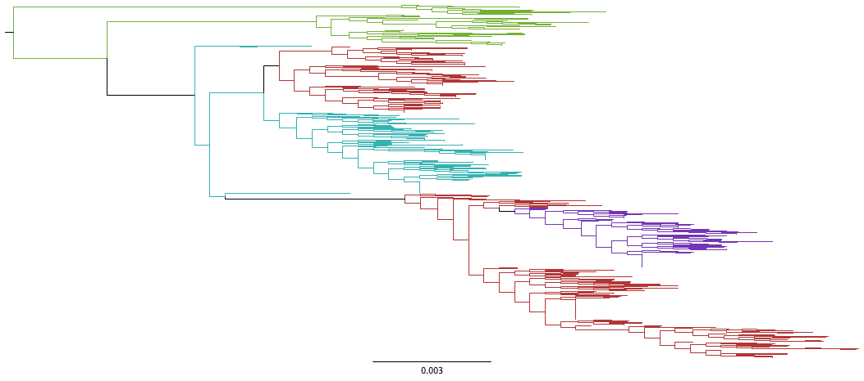
Evaluate prior selections against new genetic surveillance data
parnas -t H1N1_human_2020_IRD.rooted.tre --evaluate --prior "Vaccine.*"
[parnas] Prior selections:
Vaccine|EPI_ISL_397028|1617983|A/Hawaii/70/2019|H1N1|10/05/2019
Vaccine|EPI_ISL_404527|1661758|A/Wisconsin/588/2019|H1N1|12/19/2019
[parnas] Finding best 2 representatives:
MT245039|A/Rhode_Island/04/2020|USA|H1N1|01/08/2020
MT303640|A/New_York/17/2020|USA|H1N1|01/25/2020
[parnas] 2 Best representatives account for 34.15% of overall diversity.
[parnas] Prior representatives are 12.57% less representative than the optimal set.
[parnas] Prior strains are more representative than 96.0% of random selections.
Two existing vaccines
vs.
Two best vaccines

Slide 39
Summary
34 swine IAV HA clades detected globally over the last 6 months:
Human variants reported from 4 H1 clades (1A.3.3.2, 1B.1.1.1, 1B.2.1, 1C.2.2) and 1 H3v
IAV reassortment is difficult for swine and public health
Human-to-swine transmission is “charging the evolutionary battery”
All swine IAV maintain human IAV genes and H1N1pdm09 features
Some of the gene constellations have a significant impact on transmission efficiency (Thomas et al. 2024)
Subtle differences between strains alter phenotype and can result in zoonoses
Dairy cattle spillover: Single spillover in ~December 2023 with limited local circulation; Spillover was associated with a reassortment event in migratory birds (PB2, NP); Animal movement (HPAI status unknown) and asymptomatic dairy cattle disseminated virus; Once in dairy cattle, it has infected other hosts and is evolving
Objective selection of HA genes for characterization
All USDA-ARS-NADC software is available at https://github.com/flu-crew

Slide 40
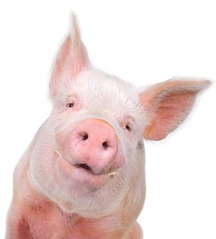



NADC flucrew
Amy Baker
Tavis Anderson
Bailey Arruda
Meghan Wymore Brand
Alexey Markin
David Hufnagel
Megan Thomas
Carine Souza
Debora Goulart
Nick Otis
Katharine Young
Celeste Snyder
Giovana Zanella
Garrett Janzen
Blake Inderski
Sid Grover
Sanket Wagle
Sriram Vijendran
Carl Hutter
Thao Nguyen
Collaborators
Phil Gauger
Oliver Eulenstein
Michael Zeller
Zeb Arendsee
Joe Thomas
IRD/BV-BRC team
Alicia Janas-Martindale/NVSL
Lauren Abrahamsen
Nicola Lewis
Daniela Rajao
Daniel Perez
Bryan Kaplan
Brian Kimble
Todd Davis/CDC
John Barnes/CDC
OFFLU
Funding:

